Slide 1
Java
Object-Oriented Programming
by BPI

Slide 2
Java
Object-Oriented Programming
What We’ll Cover Today
Four Pillars of OOP
Abstract Classes & Interfaces
Benefits of OOP

Slide 3
Java
Object-Oriented Programming
Object-Oriented Programming
“A method of programming based on a hierarchy of classes, and well-defined and cooperating classes”- Oracle Website
A programming paradigm focused on concepts of objects for effective modeling of systems
Java is inherently object-oriented
Provide brief example by mentioning a program that takes an object and processes the object

Slide 4
Java
Object-Oriented Programming
Four Pillars of OOP
Encapsulation
Inheritance
Polymorphism
Abstraction

Slide 5
Java
Object-Oriented Programming
Encapsulation
Bundling of data and methods into a single unit called a class.
Encapsulate the internal data of an object and hiding it from outside access

Slide 6
Java
Object-Oriented Programming
Encapsulation - Example
A Person has a name, age, height, weight (all marked as private) and can move() and speak()

Slide 7
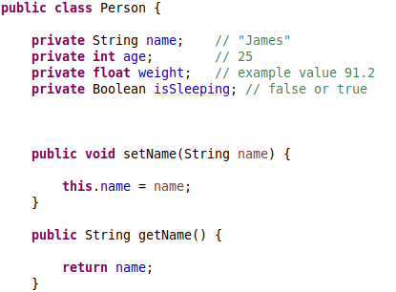
Java
Object-Oriented Programming
Encapsulation - Example

Slide 8
Java
Object-Oriented Programming
Inheritance
allows a class to inherit the attributes and methods of a parent class
Promotes code reusability
Related concepts are access modifiers, “super” keyword

Slide 9
Java
Object-Oriented Programming
Inheritance - Example
A subclass Engineer can extend the abstract class “Person”. An engineer inherits the traits of a Person. They can also move(), speak() and they also have a name, age, etc.

Slide 10
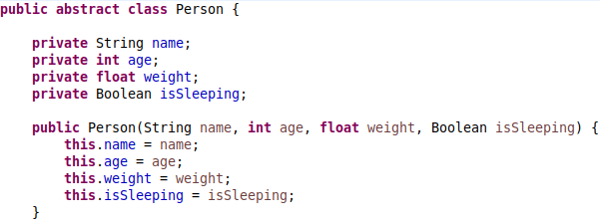
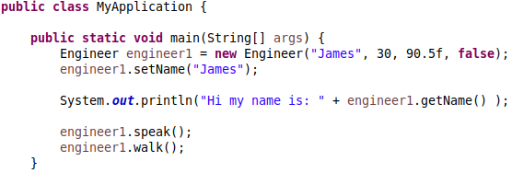
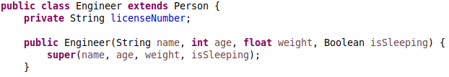
Java
Object-Oriented Programming
Inheritance - Example

Slide 11
Java
Object-Oriented Programming
Polymorphism
Allows different objects of different classes to be treated as one common super class
Promotes code flexibility
Can be implemented using “implements”, using overriding and overloading
Focuses on how an object behaves differently
Programming to an Interface

Slide 12
Java
Object-Oriented Programming
Polymorphism
“Programming to an interface” means writing code that depends on an Interface rather than its subclasses
Programming with objects based on what they can do and not what they are

Slide 13
Java
Object-Oriented Programming
Polymorphism - Example
An Engineer is a Person. A Programmer is also a person. They can share behavior and they can also have different behavior but they are all treated as a “Person”

Slide 14
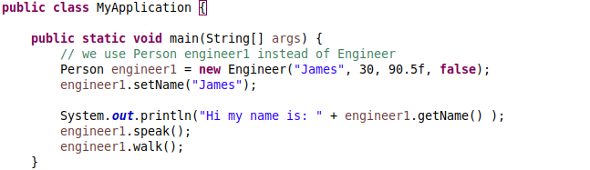
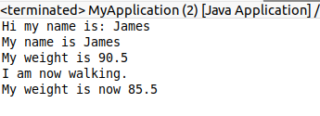
Java
Object-Oriented Programming
Polymorphism - Example

Slide 15
Java
Object-Oriented Programming
Abstraction
Simplifies classes by hiding the complexities or processes not relevant for outside objects and showing only the essential information
Promotes intuitive and efficient programming as we are only concerned with what an object has and what an object does
Focuses on what an object does
Can be implemented using abstract classes or interfaces

Slide 16
Java
Object-Oriented Programming
Abstraction - Example
A Person can have the method work(), its subclasses can have their own implementation of this method. work() for the Engineer can be “I’m an Engineer, I construct buildings” and work() for the Programmer can be “I’m a Programmer, I create software!”.

Slide 17
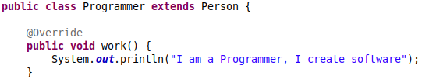

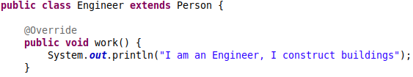
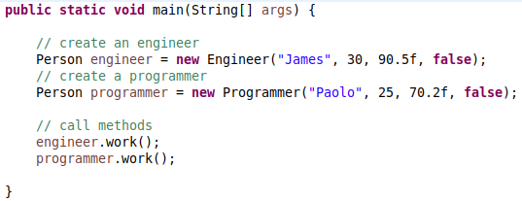
Java
Object-Oriented Programming
Abstraction - Example

Slide 18
Java
Object-Oriented Programming
Interfaces
A reference type similar to a class; uses keyword interface
Treated as a kind of contract or blueprint that implementing classes must adhere to
Can contain only fields that are constants, abstract methods, default methods, static methods
All declared fields are automatically public, static, and final. All declared methods are public
Cannot be instantiated; only implemented by classes or extended by other interfaces

Slide 19
Java
Object-Oriented Programming
Interfaces - Example
LivingThings interface and Person, Animal, Plant classes

Slide 20


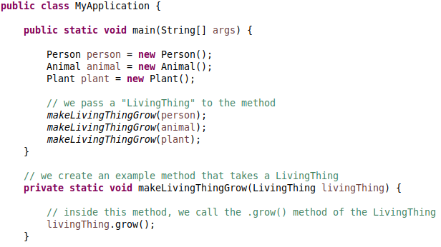
Java
Object-Oriented Programming
Interface - Example

Slide 21
Java
Object-Oriented Programming
Interface - Example (2)
Provide another example that uses services

Slide 22
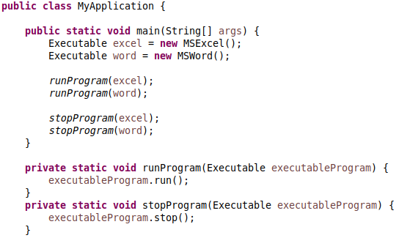

Java
Object-Oriented Programming
Seatwork 3 - Individual
Modify the classes: Executable.java, MSWord.java, MSExcel.java to make the program runnable.

Slide 23
Java
Object-Oriented Programming
Abstract Classes
Allows for partial implementation or shared logic
Can contain fields that are not static and final, abstract & concrete methods
Commonly used as a “base class”
Cannot be instantiated; only extended

Slide 24
Java
Object-Oriented Programming
Abstract Classes - Example
Person abstract class, Doctor, Engineer, and Programmer classes

Slide 25
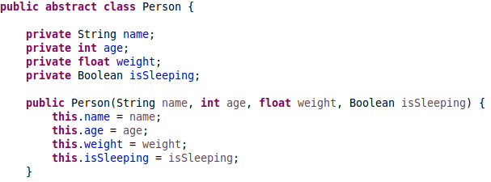
Java
Object-Oriented Programming
Abstract Classes - Example

Slide 26
Java
Object-Oriented Programming
When to use Abstract Classes
You have similar classes with shared logic
Your subclasses will have many common fields or methods and will take advantage of access modifiers

Slide 27
Java
Object-Oriented Programming
When to use Interfaces
You have seemingly unrelated classes that share a characteristic or trait
You want to specify behavior but you are not concerned who implements the behavior
Multiple inheritance

Slide 28
Java
Object-Oriented Programming
Method Overloading
Same method name but different parameters (data type or number of accepted parameters)
Example: void talkTo(Person person) and void talkTo(Animal animal) and void talkTo(Person person1, Person person2)

Slide 29
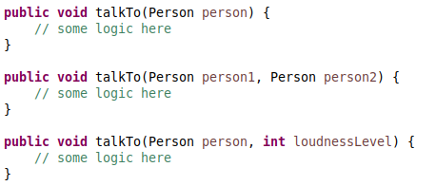
Java
Object-Oriented Programming
Method Overloading - Example

Slide 30
Java
Object-Oriented Programming
Method Overriding
Same method signature, but a different implementation from the superclass
“super” keyword allows a subclass to invoke the superclass’s method.
Example: Engineer work() can be different from Programmer work();

Slide 31

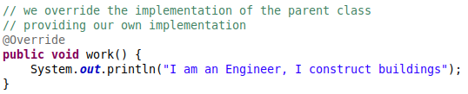
Java
Object-Oriented Programming
Method Overriding - Example

Slide 32
Java
Object-Oriented Programming
The Importance of OOP and Related Concepts
Code Flexibility
Code Reusability
Code Maintainability
Code Readability

Slide 33
Java
Object-Oriented Programming
Code Flexibility
An abstract method’s implementation can be changed without affecting the external invocation of the method in a public interface
Example 1: refer to previous example given Engineer and Programmer work();
Example 2: demonstrate “programming to an Interface”

Slide 34
Java
Object-Oriented Programming
Code Reusability
Inheritance allows code reuse and shared logic
Example 1: extending subclasses

Slide 35
Java
Object-Oriented Programming
Code Maintainability
Respecting the concept of Encapsulation and Abstraction enforces code maintainability and reduces coupling.
Coupling is the degree of interdependence between two pieces of code.
Using public instead of private for attributes increases coupling as one change could potentially require changing other parts of the code as opposed to the use of private attributes and public methods

Slide 36
Java
Object-Oriented Programming
Code Maintainability - Example
show an example of a public attribute vs a private attribute. Showcase how changing the data type will add more work

Slide 37
Java
Object-Oriented Programming
Code Readability
Effective use of the OOP concepts make code more readable and easier to use with other pieces of code

Slide 38
Java
Object-Oriented Programming
Exercise 2 - Individual
Create Interface “Refuelable”. Implementing classes should be able to implement method “refuel()”
Create Abstract Class “Vehicle”. Extending classes should have attributes “numberOfWheels” and “brand” and should have an abstract method “startEngine()”, it should have a concrete method “void destroy()”.
Create two concrete classes “Car” and “Truck”. It must implement “Refuelable” and extend “Vehicle”.
In your Main Application, create one Car and one Truck and call the methods they inherited / implemented.
In your Main Application, create a method called “destroyVehicle” that takes ONE parameter (either a Car or Truck) and call their “destroy()” method.

